Slide 1

CREATING A PERSONAL GIT/GITHUB REPOSITORY

Slide 2

Making a Personal Git(Hub) Repo
Git and GitHub are powerful tools for maintaining good code.
They allow us to checkpoint via commits, and give us the power to move back in time if we break our code.
GitHub allows us to create an online backup of our code and also share it with others, even allowing multiple people to make changes to the same code base.

Slide 3
What’s in this Walkthrough?
Worked code for setting up your own Git(Hub) repo, broken into 2 sections
Section 1: creating a Git repo on your local computer
Section 2: using this Git repo to create a linked GitHub repo

Slide 4
Section 1: Building a local repo

Slide 5
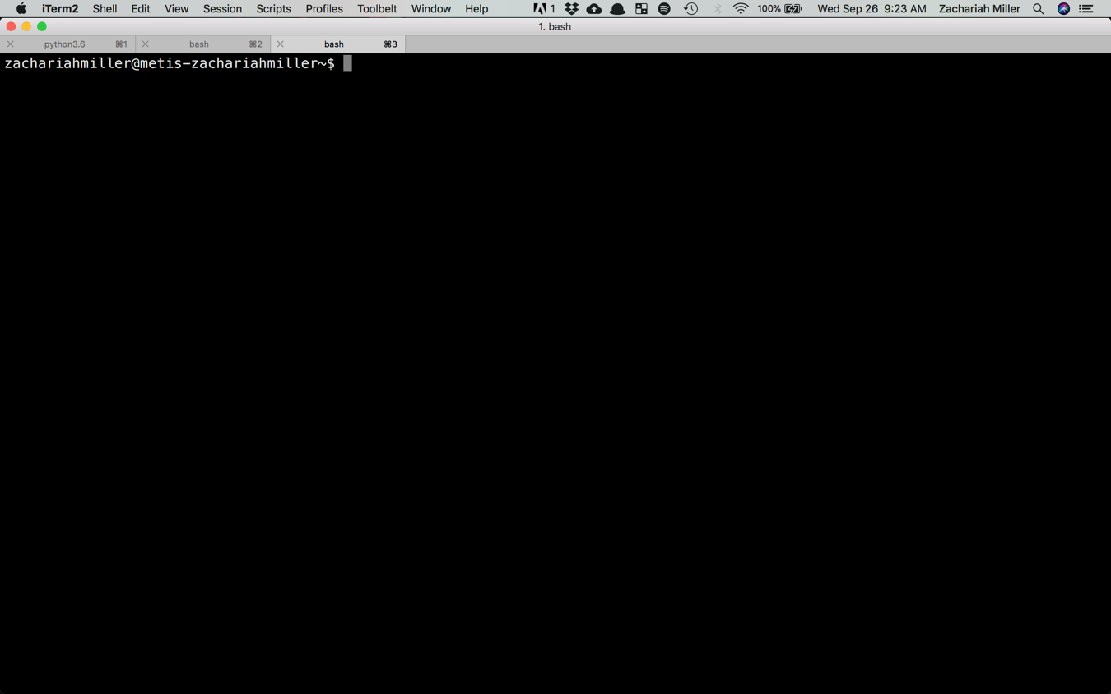

Slide 6
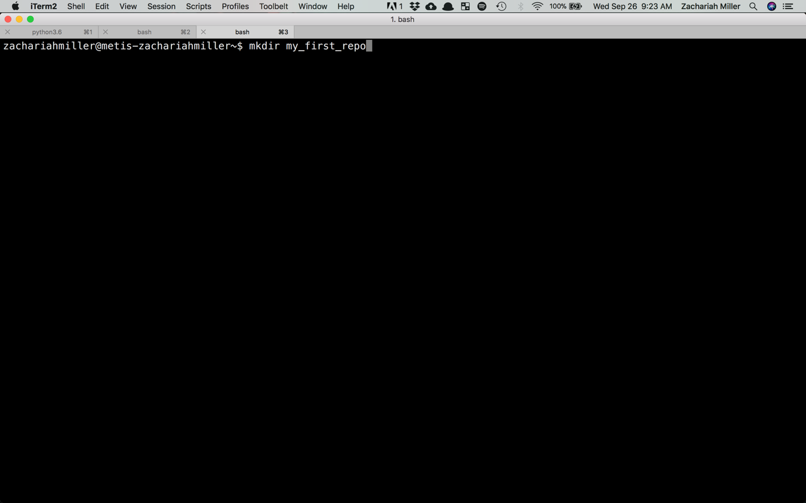

Slide 7
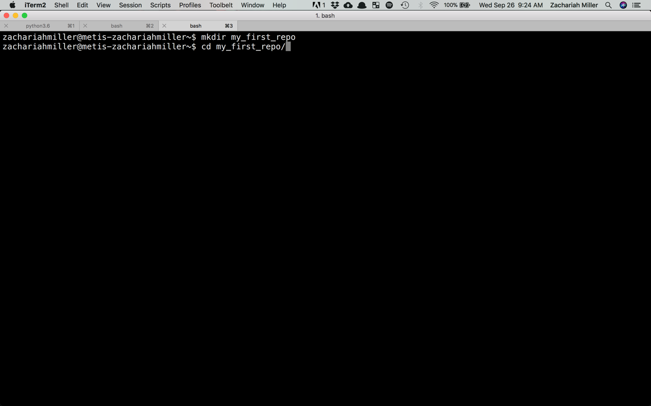

Slide 8
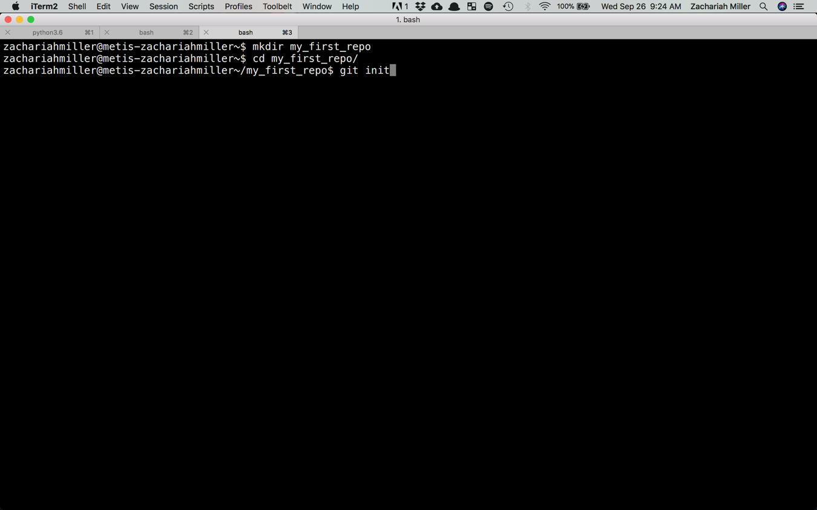

Slide 9
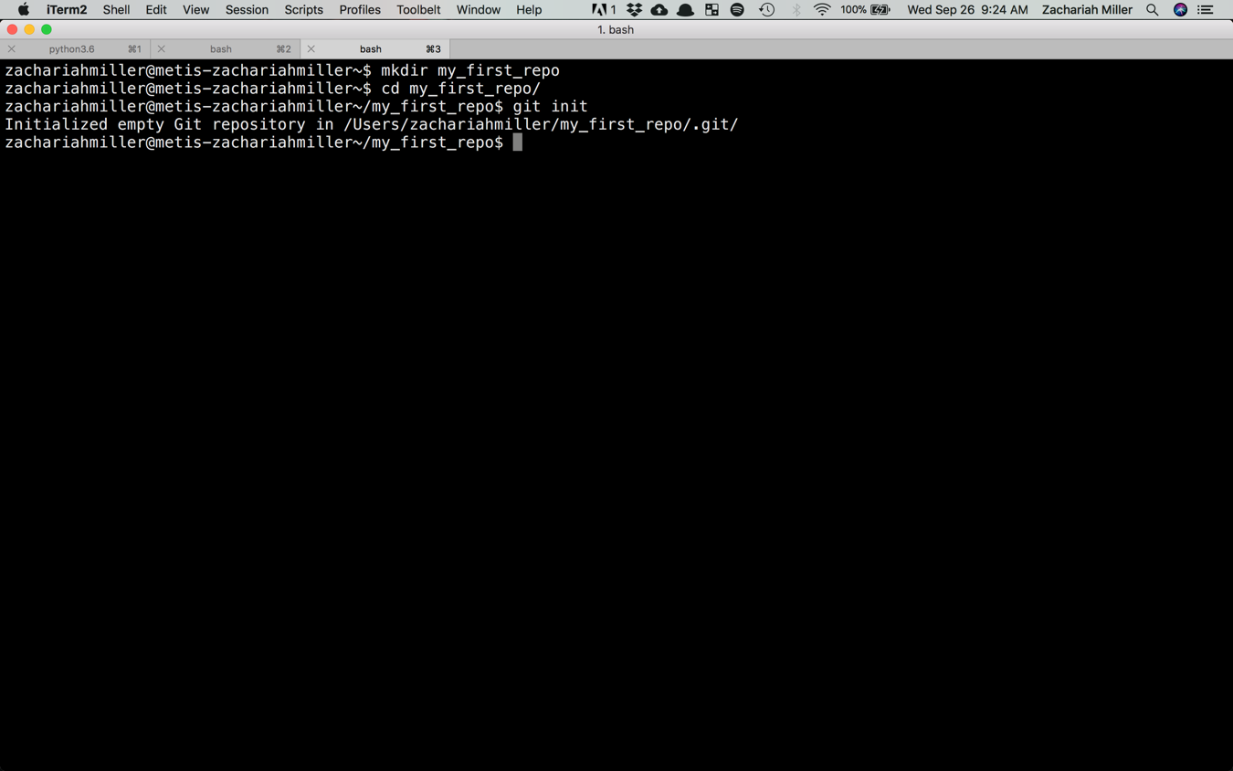

Slide 10
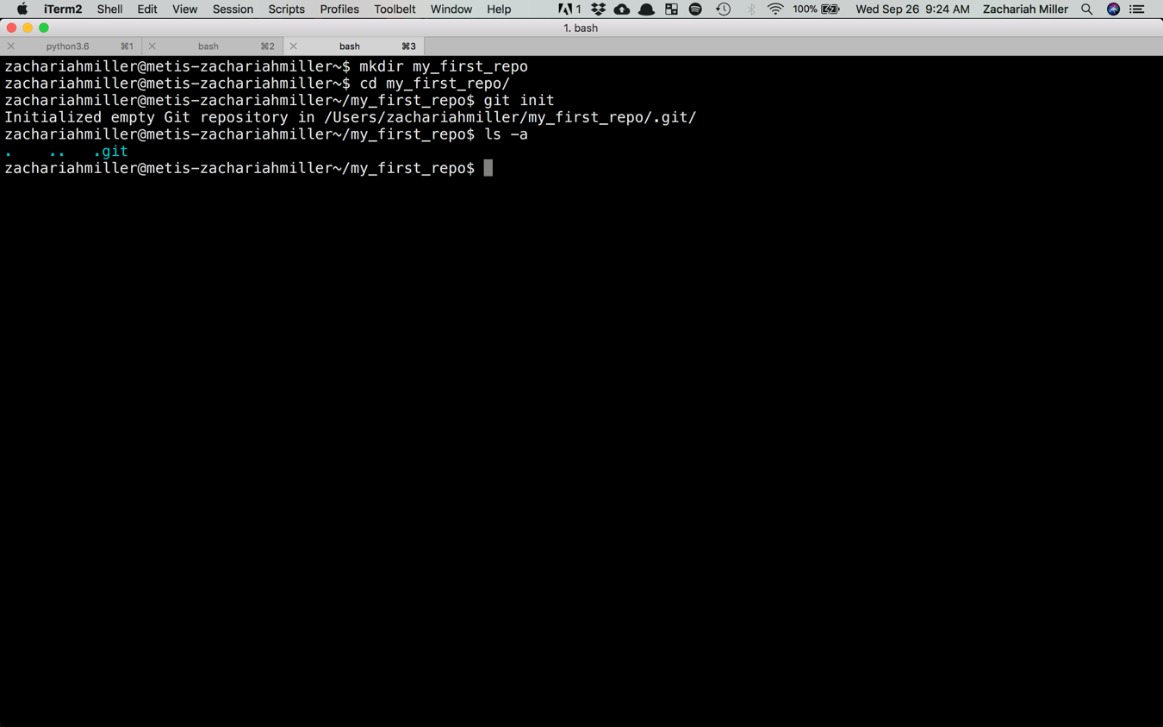

Slide 11
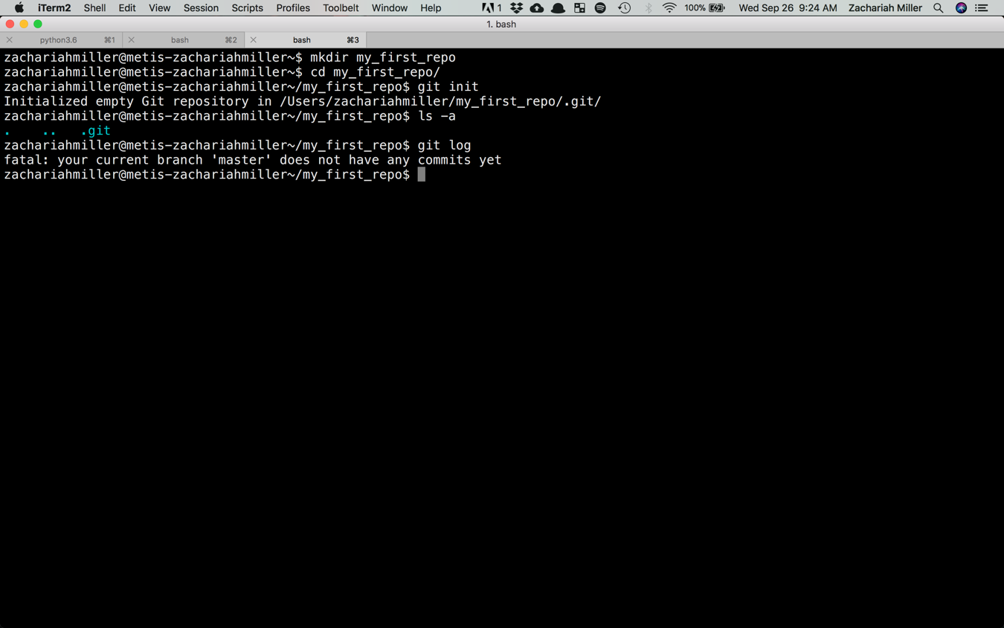

Slide 12
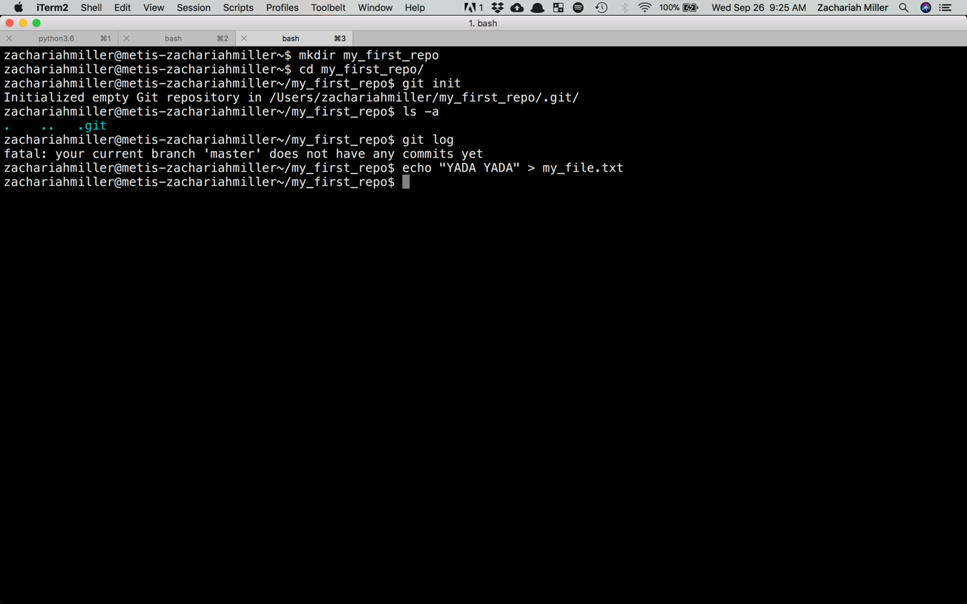

Slide 13
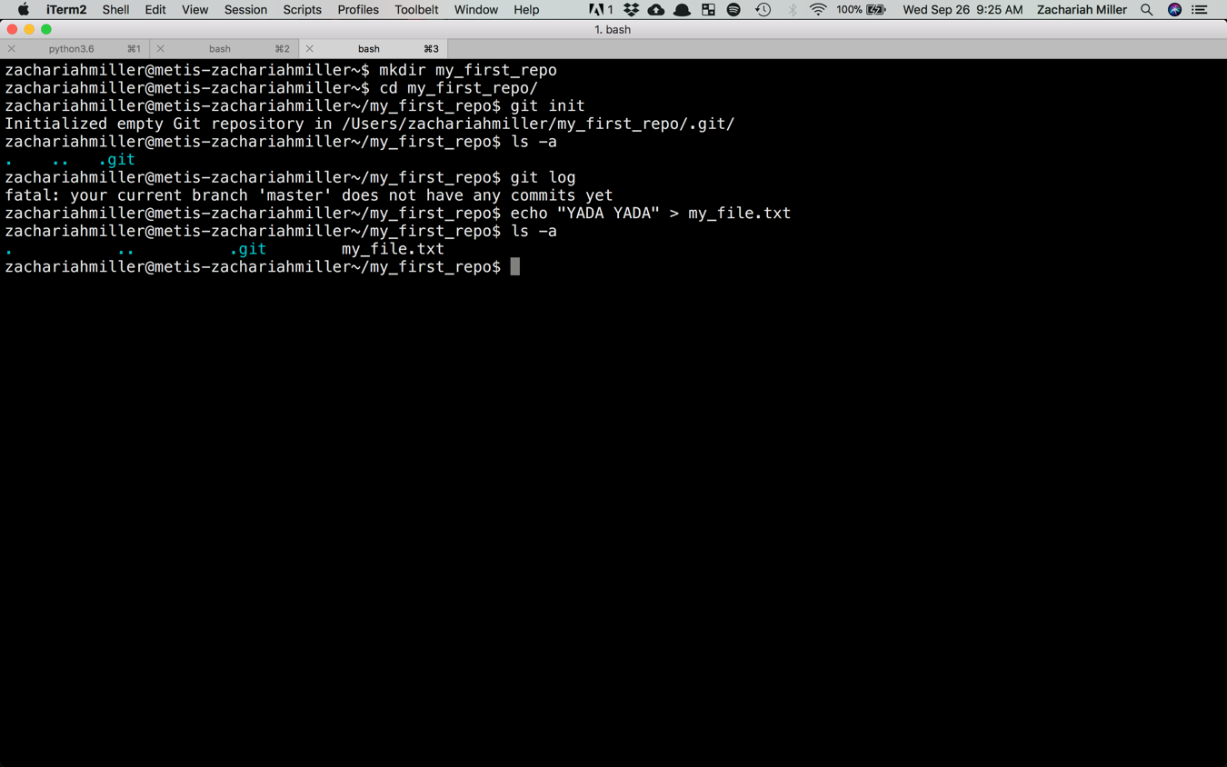

Slide 14
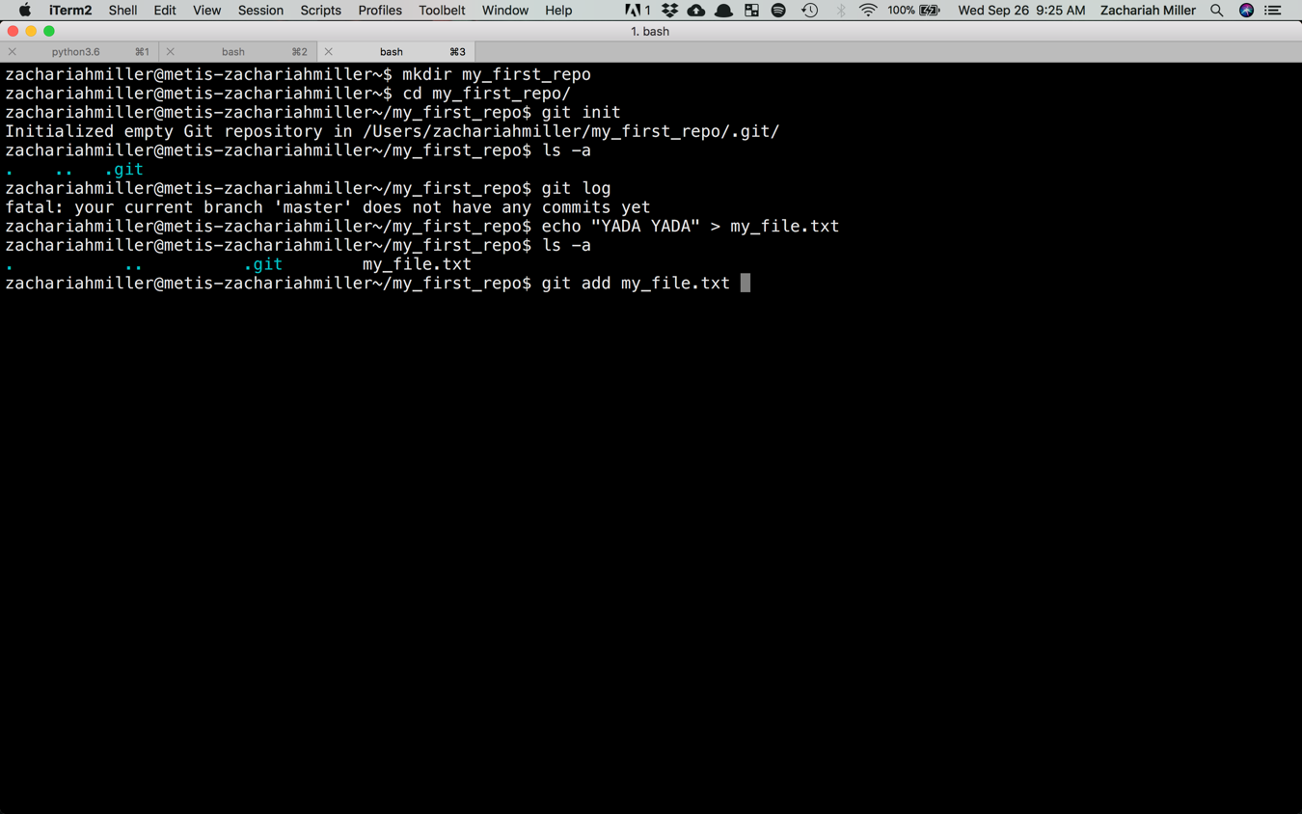

Slide 15
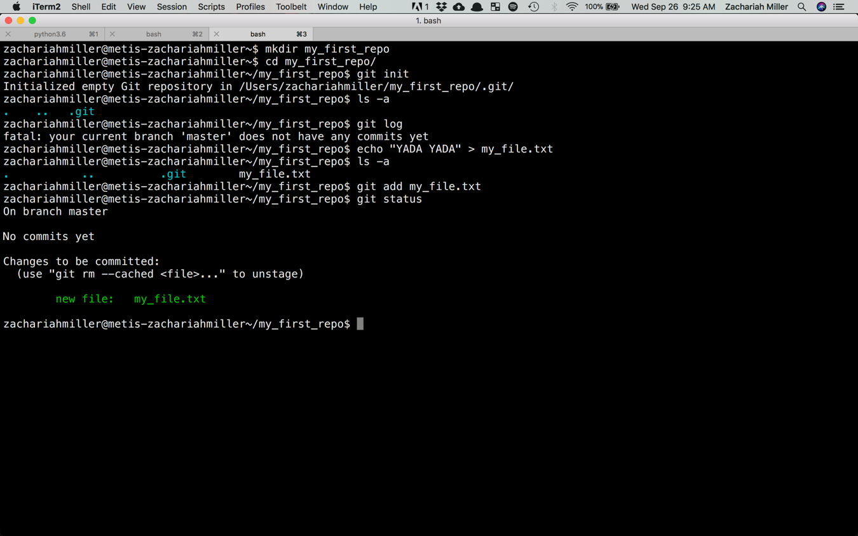

Slide 16
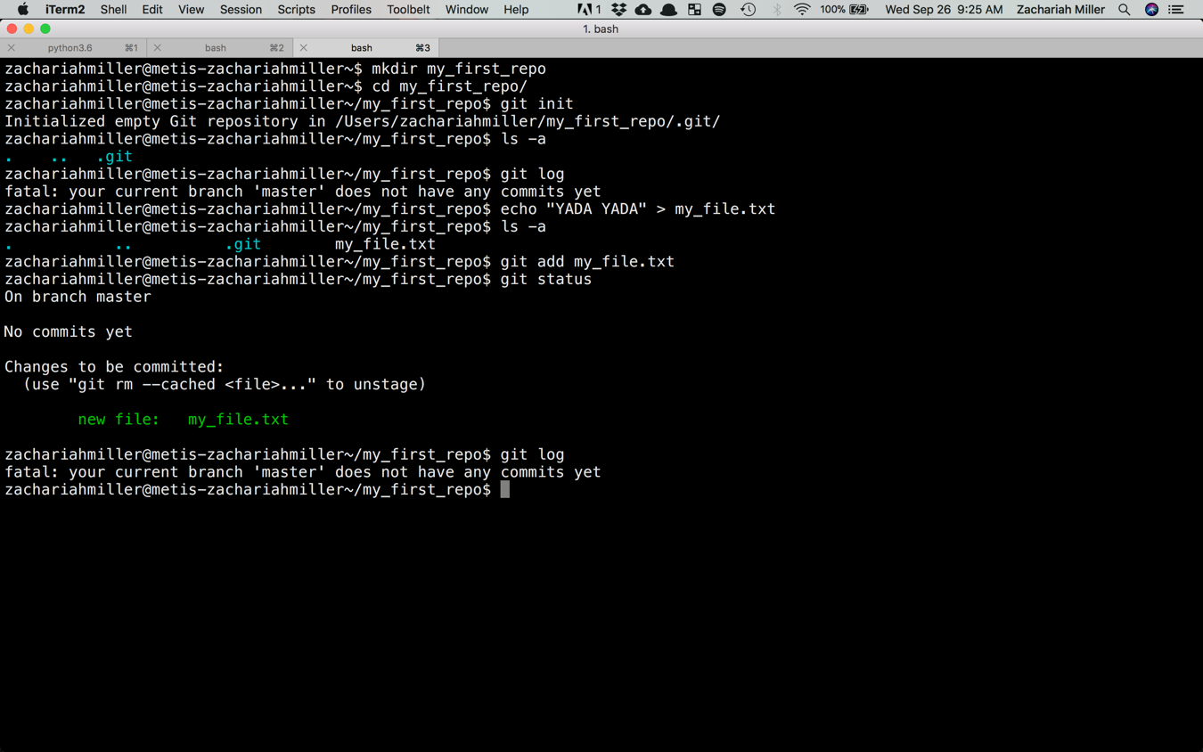

Slide 17
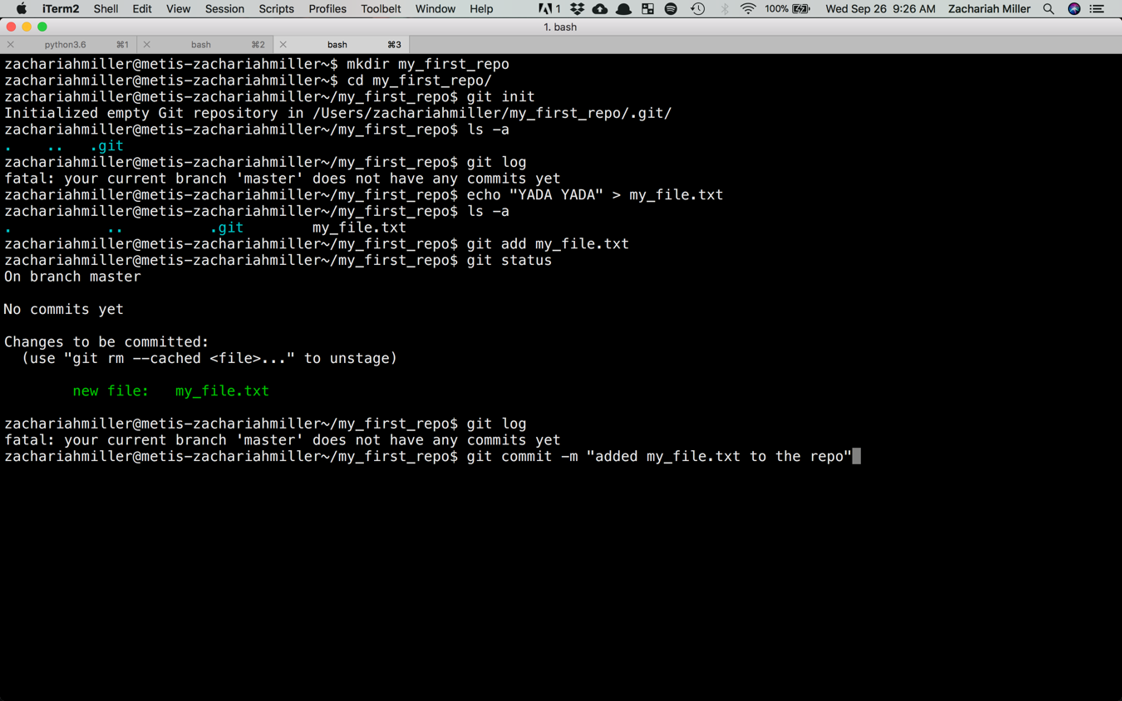

Slide 18
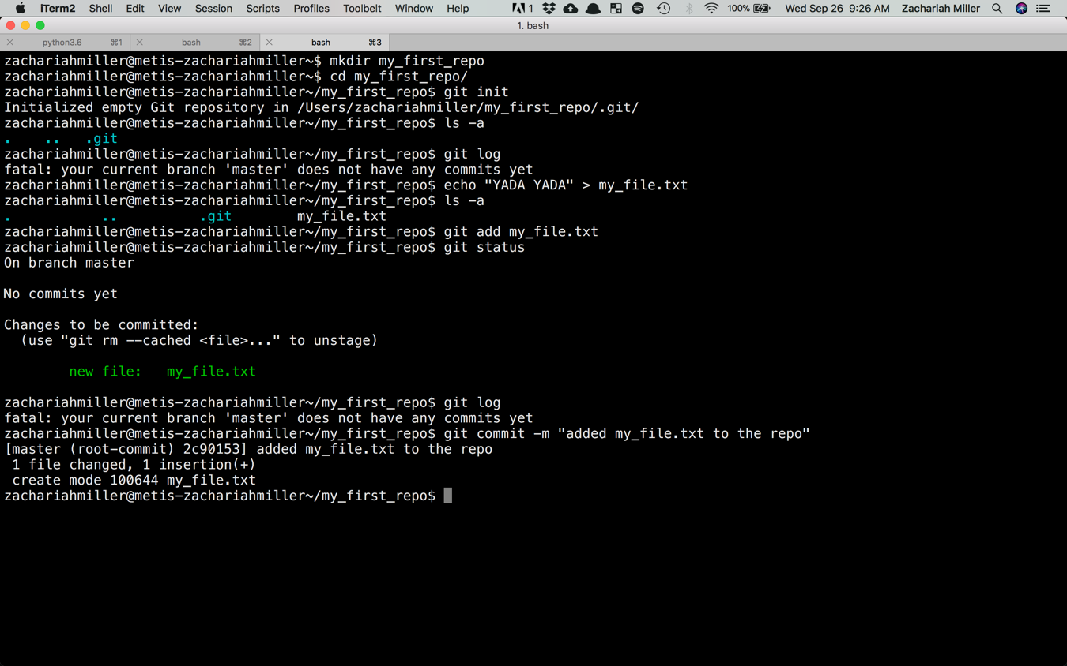

Slide 19
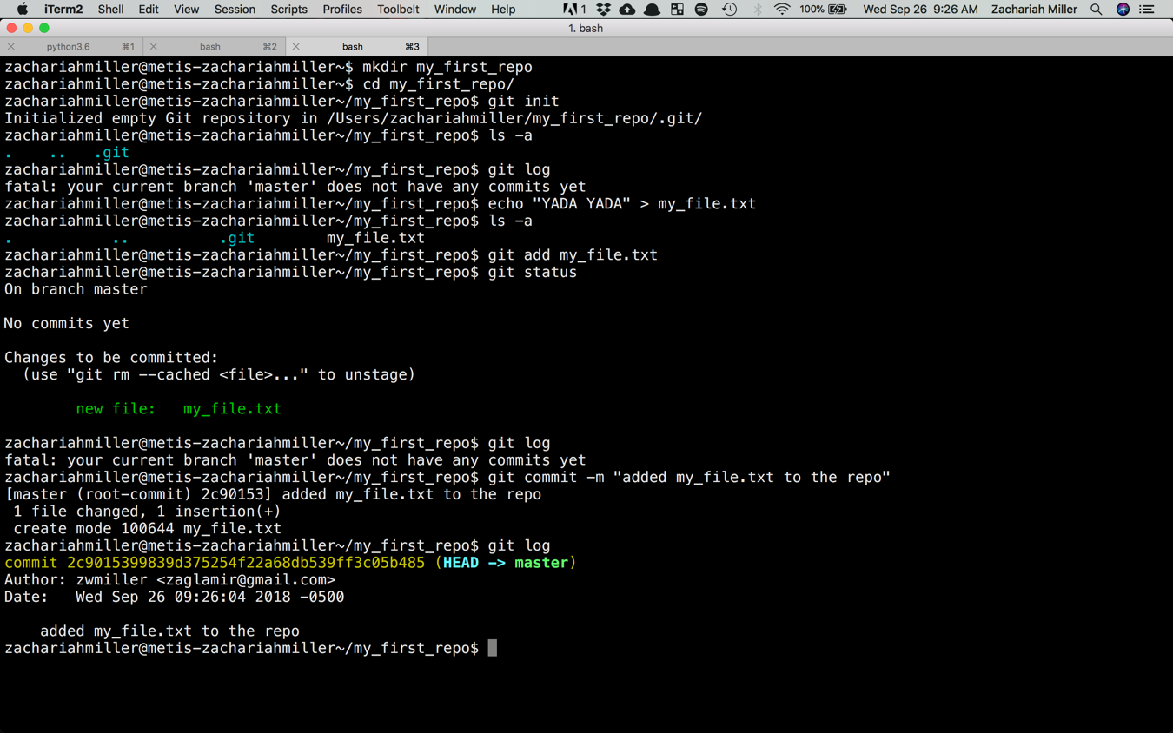

Slide 20
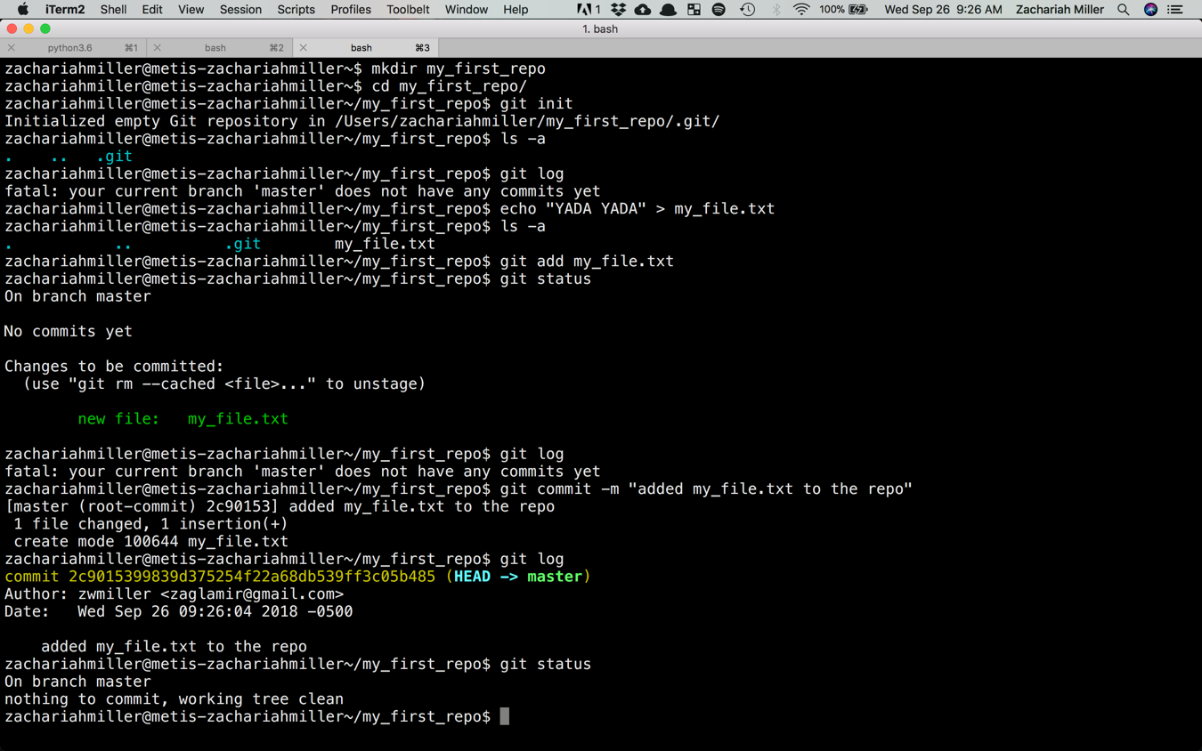

Slide 21
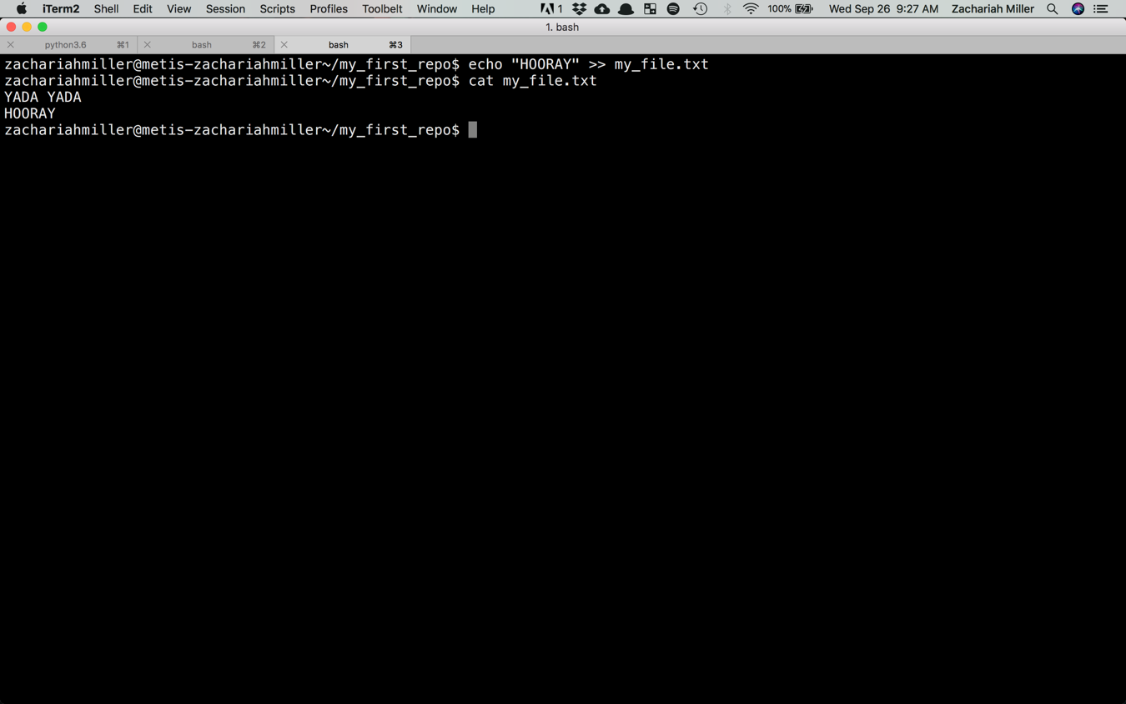
Now, let’s edit the file by appending some new text.
Make a commit following the procedure we just did.
Use git log to prove to yourself there are two commits now.
We’ll run through a solution in about 5 minutes.

Slide 22
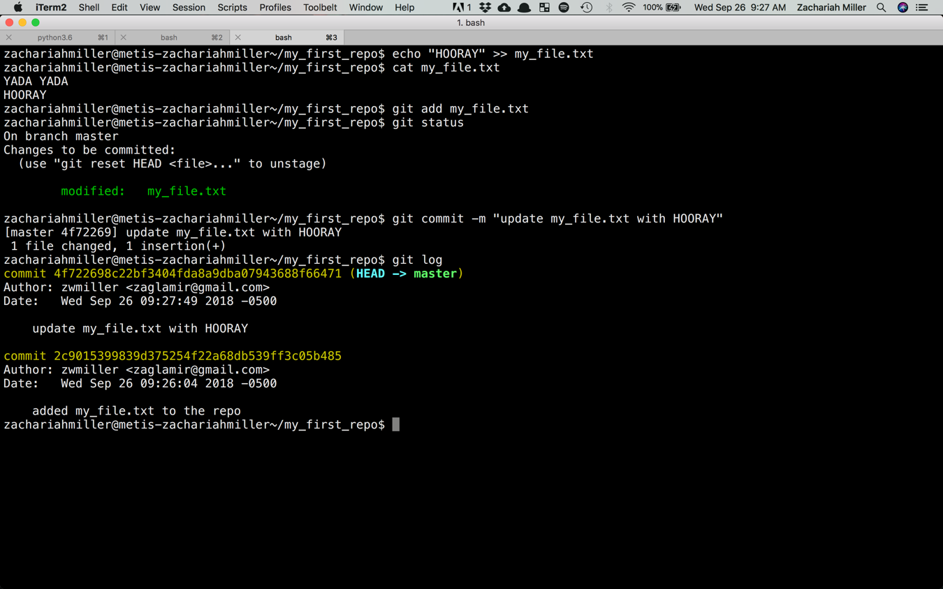

Slide 23
Reverting to a previous point

Slide 24
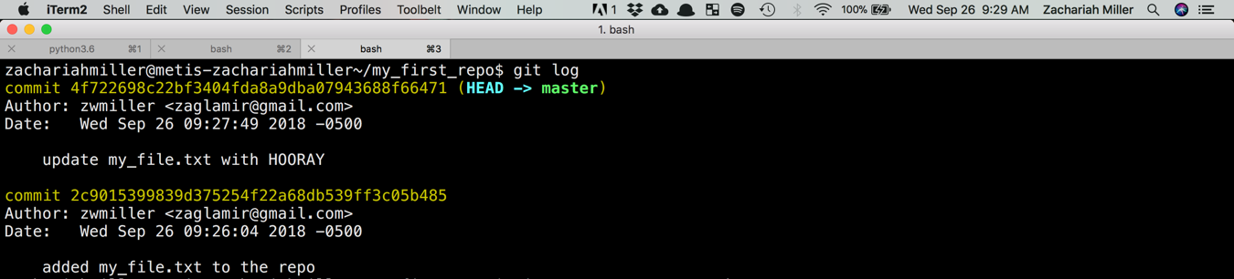

Slide 25
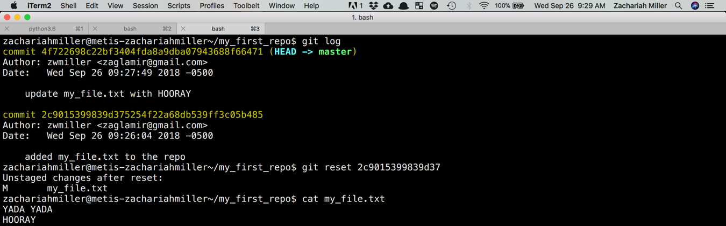

Slide 26
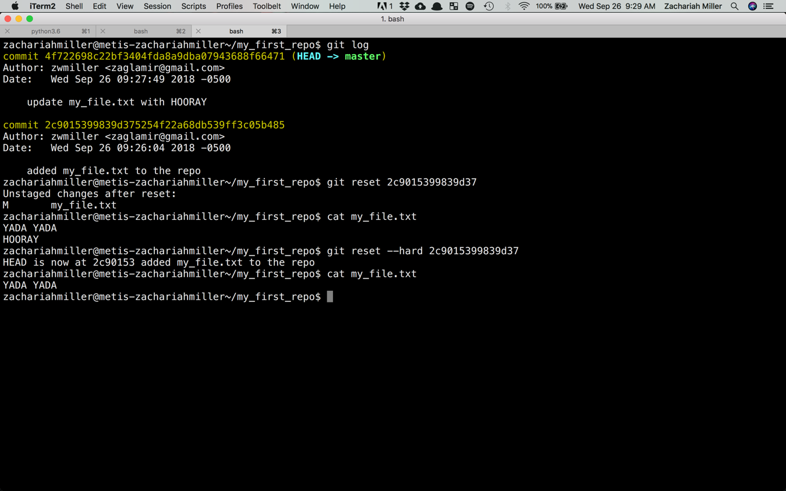

Slide 27
Section 2: Making your repo remote

Slide 28
Let’s start by creating a repo on GitHub called “Test”

Slide 29
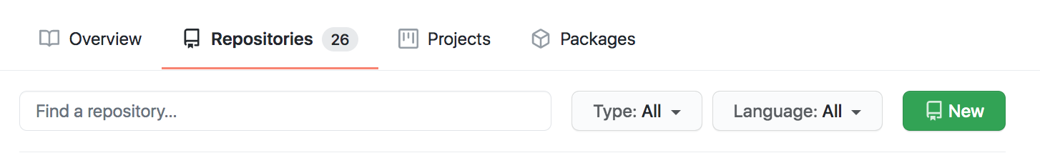
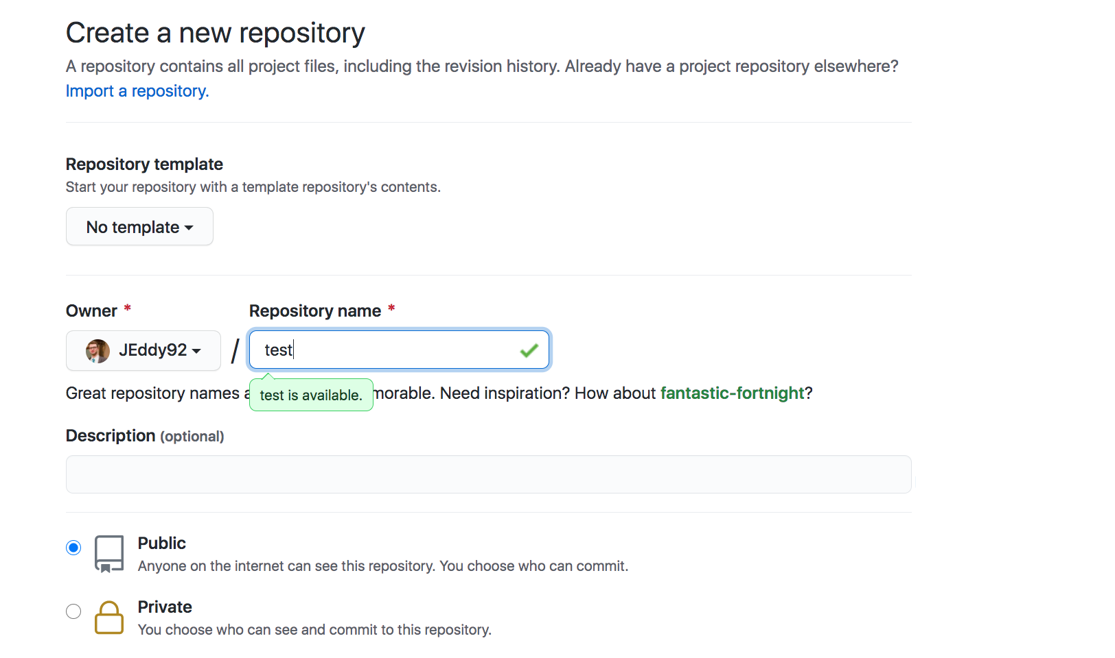
Navigate to the “repositories” section of your GitHub profile, press new, and fill in the repo name before hitting “create repository”

Slide 30
Connecting GitHub to our Local Repo
We now have a remote repo (on GitHub) and the local one where we put our test files. Let’s link those together.
First, in the terminal, move to the repo we started earlier. You need to be in the folder where we did the git init earlier.
(or any directory below that)

Slide 31
Connecting GitHub to our Local Repo
We now have a remote repo (on GitHub) and the local one where we put our test files. Let’s link those together.
Terminal:> git remote add origin URL_FROM_GITHUB
This tells git about the non-local version of the repo

Slide 32
Connecting GitHub to our Local Repo
We now have a remote repo (on GitHub) and the local one where we put our test files. Let’s link those together.
Terminal:> git remote add origin URL_FROM_GITHUB
This tells git we’re adding a new remote place to interface with

Slide 33
Connecting GitHub to our Local Repo
We now have a remote repo (on GitHub) and the local one where we put our test files. Let’s link those together.
Terminal:> git remote add origin URL_FROM_GITHUB
This tells git that we’re going to call this remote place “origin” (it’s convention)

Slide 34
Connecting GitHub to our Local Repo
We now have a remote repo (on GitHub) and the local one where we put our test files. Let’s link those together.
Terminal:> git remote add origin URL_FROM_GITHUB
Specific github url for your repo, e.g. https://github.com/[YOUR_USERNAME]/test

Slide 35
Connecting GitHub to our Local Repo
Make sure it worked by testing your remote locations using:
I see an output like this:
Terminal:> git remote -v
origin https://github.com/ZWMiller/test (fetch)
origin https://github.com/ZWMiller/test (push)

Slide 36
Connecting GitHub to our Local Repo
Now let’s move our code to GitHub
When we go back to our GitHub and refresh, we should see out files there!
Terminal:> git push origin main

Slide 37
Connecting GitHub to our Local Repo
Now let’s move our code to GitHub
Terminal:> git push origin main
This told git we wanted to move our commit history up to GitHub

Slide 38
Connecting GitHub to our Local Repo
Now let’s move our code to GitHub
Terminal:> git push origin main
This told git to use the remote place we just created called “origin”

Slide 39
Connecting GitHub to our Local Repo
Now let’s move our code to GitHub
Terminal:> git push origin main
This told git to put those changes on the “main” (default) branch.

Slide 40
Best Practices
It’s a great idea to keep a GitHub repo for all code projects that you work on, especially for Metis courses! If the repo is maintained, this ensures that you have a backup of your code and are easily able to share and showcase your finished work.
It’s a good idea to commit/push often. You can do so after every completed “point” in code. Finished a few functions that now work together? Commit. Updated comments in the code? Commit.

